Slide 1
Rome Was Not Built in a Single Step: Hierarchical Prompting for LLM-based Chip Design
Andre Nakkab, Sai Qian Zhang, Ramesh Karri, Siddharth Garg

Slide 2
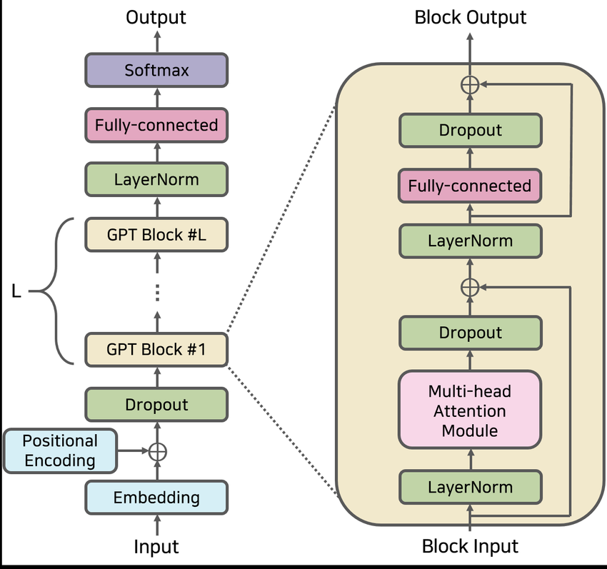

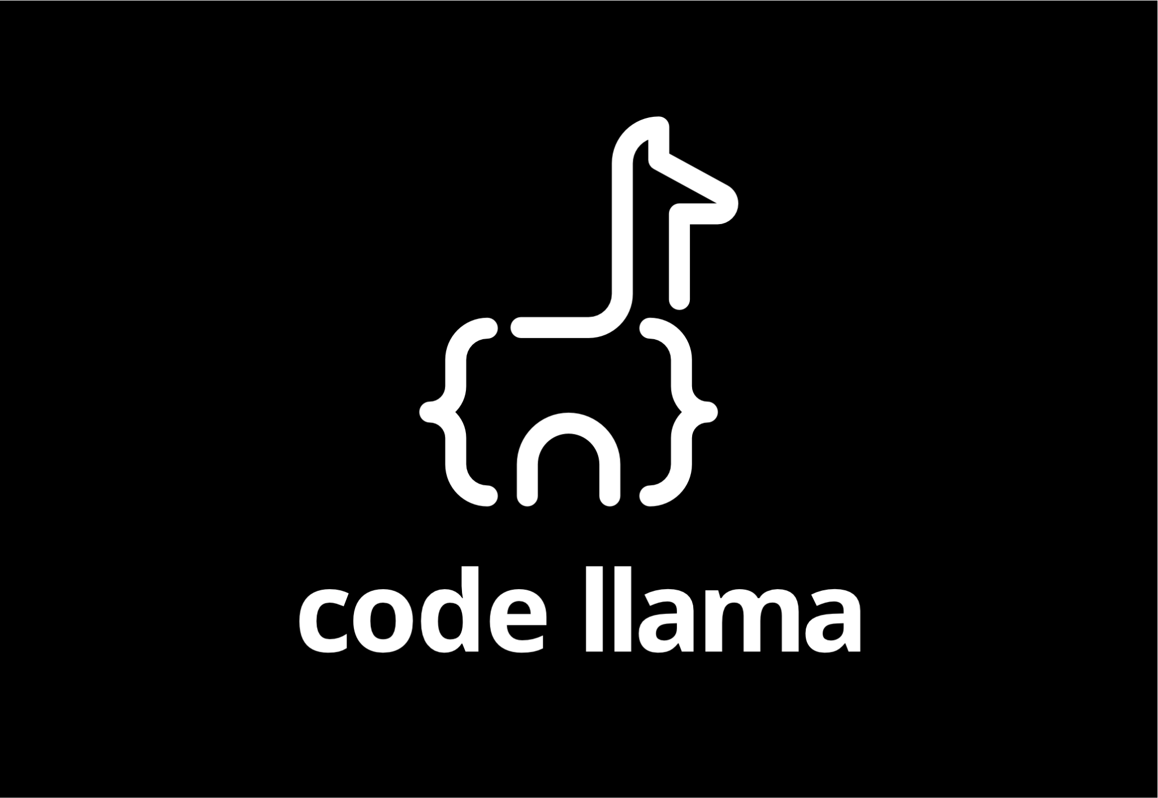


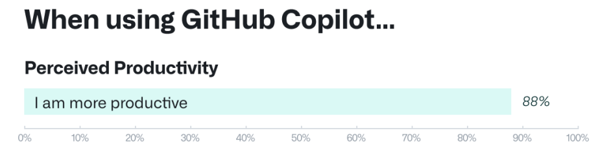
Intro to LLMs
Usage in Software:
Sources: A Mathematical Investigation of Hallucination and Creativity in GPT Models, Lee et al.,
Quantifying GitHub Copilot’s impact on developer productivity and happiness, Eirini Kalliamvakou

Slide 3
Related Work
LLMs for software code
CodeGen [1] and Code Llama [2]
LLMs for HDL
VeriGen [3]: first open-source model for Verilog
RTLCoder [4]: current SOTA Verilog model
ChipChat [5]: uses ChatGPT and human feedback
Datasets and Benchmarks
Verilog-GitHub: 1.89 GB scraped from GitHub
Approximately 712 million tokens
VerilogEval: 300 test problems with prompts and testbenches

Slide 4
Existing SotA: Flat Prompting
Target Module
Module Prompt
GPT-4 Output
module mux64to1(input [63:0] in, input [5:0] select, output reg out);
always @ (in or select)
begin
case(select)
6'd0 : out = in[0];
6'd1 : out = in[1];
6'd2 : out = in[2];
6'd3 : out = in[3];
// Continue specifying each input...
6'd60: out = in[60];
6'd61: out = in[61];
6'd62: out = in[62];
6'd63: out = in[63];
default: out = 1'bx; endcase
end
endmodule
64-to-1 Mux
We will be generating a 64-to-1 multiplexer in Verilog. The module is defined as:
module mux64_1(
input [63:0] data_in,
input [5:0] select,
output reg data_out
)
MUX

Slide 5

But How Do Humans Code?
Design an 8-bit UART
Receiver
Transmitter
Baud Rate Generator
RST
IDLE
IDLE
START
DATA
STOP
DATA
STOP
Source: https://github.com/hell03end/verilog-uart

Slide 6
Our Solution: Hierarchical Prompting
Global Prompt: We will be designing a 64-to-1 multiplexer in Verilog using hierarchical submodules.
We begin by generating a 2-to-1 multiplexer with the following structure…
1
We have access to a 2-to-1 multiplexer, and a 4-to-1 multiplexer defined as…
Using these modules, we generate an 8-to-1 multiplexer…
2
module Mux64to1( input [63:0] in, input [5:0] sel, output out);
wire out0, out1;
Mux32to1 MUX0 ( …
3

Slide 7






ROME Hierarchical Pipeline
Error handling sub-loop
Feedback Template
Error
prompt
Simulation feedback
Hierarchical
Submodule List
(Human or LLM)
Editing
Finalized Hierarchical Module
Error
Generate hier prompt
LLM
Testing & Simulation
Submodule
Verilog
Assemble submodules
No Error
HDL Hierarchy Step
Proceed to next submodule

Slide 8




ROME Modes of Operation
Human-driven Hierarchical Prompting (HDHP)
Purely-generative Hierarchical Prompting (PGHP)
Human provides hierarchy
They can also provide testbenches for unit tests
LLMs generates hierarchy!
Only top-level testbench provided but no unit tests

Slide 9
New Hierarchical Benchmark Suite
Top-modules | Submodule count
64-to-1 multiplexer | 6
5-to-32 decoder | 3
32-bit Barrel Shifter | 5
4x4 Systolic Array | 6
8-bit UART | 6
128-bit AES Block Cipher | 16
Total Submodules | 42
Average Hierarchy Depth | 7
Top module description
Submodule descriptions
Top-level testbench
Submodule testbenches

Slide 10
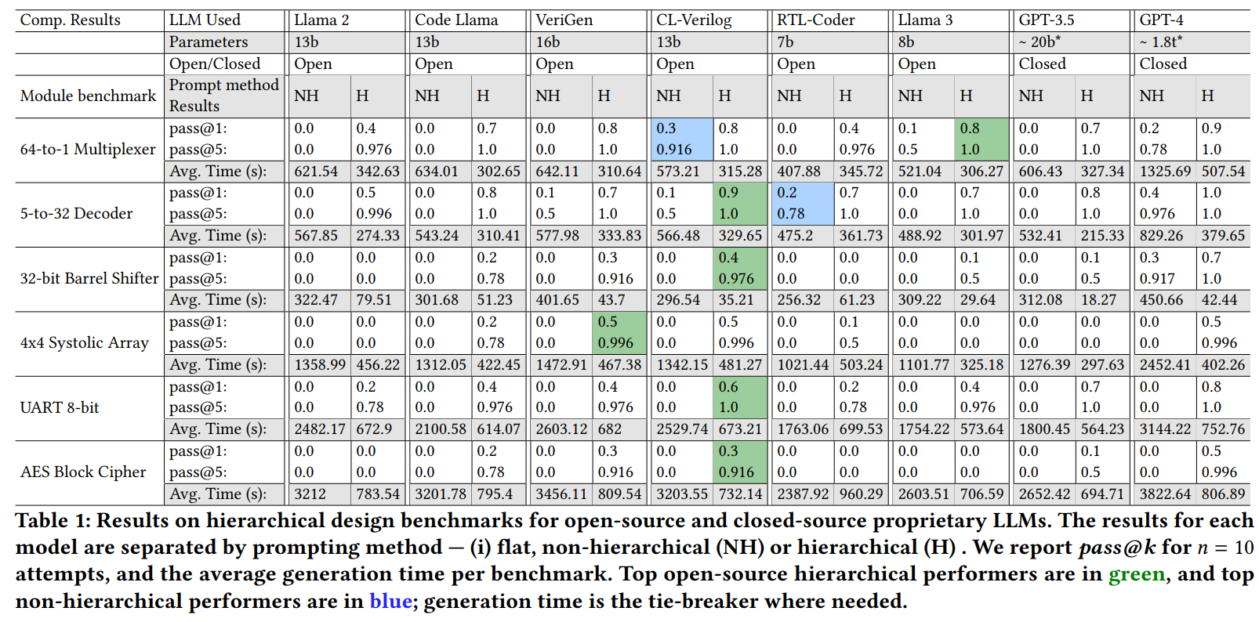
Results

Slide 11
Results

Slide 12
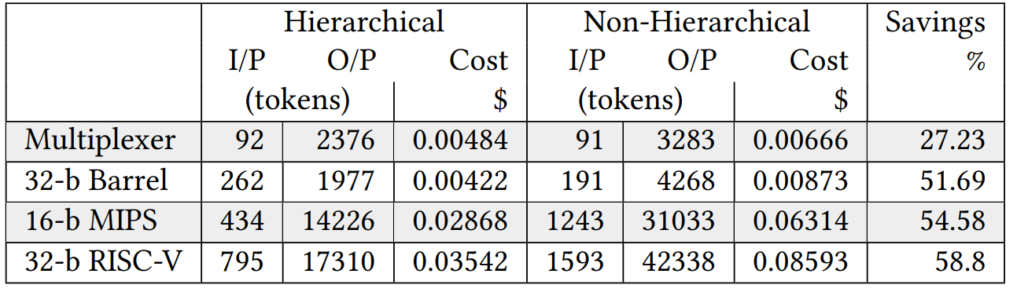
Cost Analysis
Based on GPT-3.5 Tokenizer

Slide 13
Purely Generative Results
GPT-4 Results | Mux | Decoder | Barrel Shift. | Sys. Array | UART | AES
pass@1 flat | 0.2 | 0.4 | 0.3 | 0.0 | 0.0 | 0.0
pass@5 flat | 0.78 | 0.976 | 0.917 | 0.0 | 0.0 | 0.0
pass@1 PGHP | 0.5 | 1.0 | 0.3 | 0.1 | 0.3 | 0.0
pass@5 PGHP | 0.996 | 1.0 | 0.917 | 0.5 | 0.916 | 0.0

Slide 14
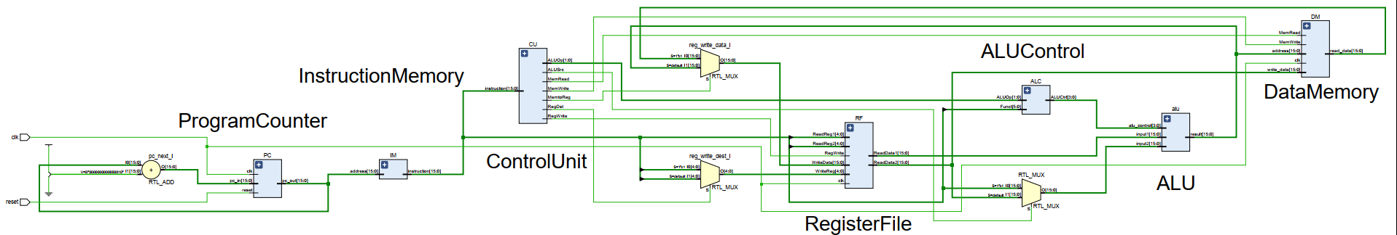
Fully Automated Processor Generation!
MIPS Processor Generated using ROME-based PGHP.
Fully functional
OpCodes differ from MIPS ISA
Passes bespoke testbenches
No human feedback whatsoever, a world first

Slide 15
Future Work
Include ROME as an element of a larger SoC builder tool
Continue to improve CL-Verilog
Explore multimodal inputs to enhance performance on HDL generations task, train an open-source multimodal CLIP-like HDL generation model
Expand benchmark further with more modules and improved testbenches
Develop a better protocol for PGHP, likely via recent improvements in LLM-based testbench generation
Use ensemble of LLMs to maximize efficiency, minimize cost

Slide 16
References
Nijkamp, E., Pang, B., Hayashi, H., Tu, L., Wang, H., Zhou, Y., ... & Xiong, C. (2022). Codegen: An open large language model for code with multi-turn program synthesis. arXiv preprint arXiv:2203.13474.
Roziere, B., Gehring, J., Gloeckle, F., Sootla, S., Gat, I., Tan, X. E., ... & Synnaeve, G. (2023). Code llama: Open foundation models for code. arXiv preprint arXiv:2308.12950.
Thakur, S., Ahmad, B., Pearce, H., Tan, B., Dolan-Gavitt, B., Karri, R., & Garg, S. (2024). Verigen: A large language model for verilog code generation. ACM Transactions on Design Automation of Electronic Systems, 29(3), 1-31.
Liu, S., Fang, W., Lu, Y., Zhang, Q., Zhang, H., & Xie, Z. (2023). Rtlcoder: Outperforming gpt-3.5 in design rtl generation with our open-source dataset and lightweight solution. arXiv preprint arXiv:2312.08617.
Blocklove, J., Garg, S., Karri, R., & Pearce, H. (2023, September). Chip-chat: Challenges and opportunities in conversational hardware design. In 2023 ACM/IEEE 5th Workshop on Machine Learning for CAD (MLCAD) (pp. 1-6). IEEE.

Slide 17

Question & Answer
Andre Nakkab
ajn313@nyu.edu

